Slide 1
Online Shop

Slide 2
Customer Activity
Customer
register
filling form
loging
order
Select products
check oute
invoice
payment

Slide 3
Provider activity
Admin
user administration
Product administration
add product , delete , Edite
Order /edit / add acceptation
login

Slide 4
Use Case
Brows Product
Customer
Admin
Order Product
Offer Product
Perform Order

Slide 5
Customer and Product relation
Customer
product
N
Order
M

Slide 6
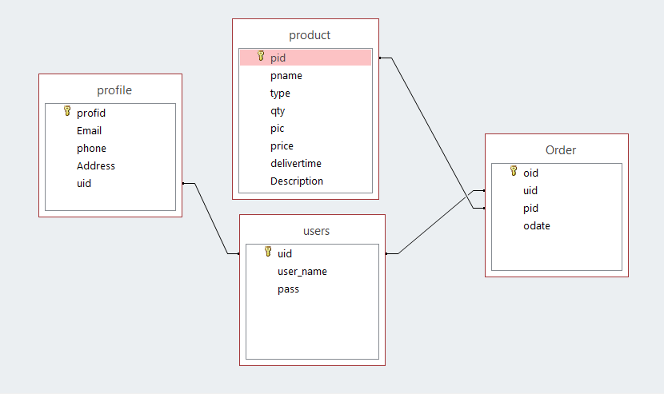
Database

